Slide 1
Progress Presentation
Health-Wise Lifespan Assessment using IoT and AI
by
Hardik Sen
Reg No. 210907288
Under the guidance of
Internal Guide External Guide
Prof. Prashant M Prabhu Dr. Spoorthi Singh
ECE, MIT Manipal Mechatronics, MIT Manipal

Slide 2
Recap of Previous Presentation
Dataset Creation Process: Explained data collection, feature selection, and preprocessing steps.
Dataset Preview: Showcased key attributes and initial insights from the dataset.
Validation & Accuracy Proof: Demonstrated lifespan trends evaluation metrics ensuring reliability.
Key Findings: Highlighted trends, correlations, and critical insights from the dataset.

Slide 3
Contents
Introduction
ML Model Selection
Data Preparation & Splitting
Preprocessing & Pipeline Setup
Model Training & Evaluation
References
Next Presentation Overview

Slide 4
Introduction
We are training a machine learning model to predict life expectancy based on various lifestyle and health factors.
The model learns from the dataset we created, identifying patterns that impact longevity.
Our goal is to create a highly accurate prediction system that can provide insights for better health decisions.
This training will lay the foundation for fine-tuning a generative model to offer personalized health recommendations in the future.

Slide 5
ML Model Selection
We selected XGBoost (Extreme Gradient Boosting) for training our model
Comparison with Other Models: [ Reference [1] ]
Linear Regression → Too simplistic; fails to capture complex health & lifestyle interactions.
Decision Trees → Prone to overfitting and lack ensemble strength.
Random Forest → More stable but computationally expensive and slower.
Why XGBoost?
Optimized for Tabular Data → Works well with structured datasets.
High Accuracy → Boosts weak learners into strong models.
Fast & Efficient → Outperforms traditional tree-based models.
Regularization → Controls overfitting for better generalization.
Feature Importance Analysis → Identifies key health & lifestyle factors.

Slide 6
Data Preparation & Splitting
Loading the Data → Imported and preprocessed our dataset.
Feature & Target Extraction:
Features (X): All health & lifestyle factors.
Target (y): Life Expectancy.
Splitting the Data:
80% Training Set → Used for model learning.
20% Testing Set → Used for evaluation.

Slide 7
Preprocessing & Pipeline Setup
Feature Engineering:
Categorical Features: (e.g., Gender, Country, Diet Type) → One-Hot Encoded.
Numerical Features: (e.g., BMI, Sleep Hours, Exercise) → Standard Scaled.
Pipeline Construction:
Step 1: One-Hot Encoding for categorical variables.
Step 2: Standard Scaling for numerical variables.
Step 3: XGBoost Regressor for prediction.
Why a Pipeline? → Ensures automated, efficient, and structured data processing

Slide 8
Model Training & Evaluation
Training the Model:
Used Bayesian Optimization (BayesSearchCV) for hyperparameter tuning.
Then apply the Pipeline.
Best Score Achieved:
Evaluated using Accuracy Score (0.89).
Feature Importance:
Determined which factors contribute most to lifespan prediction.
Saving the Model:
Exported as a .pkl file for future inference

Slide 9
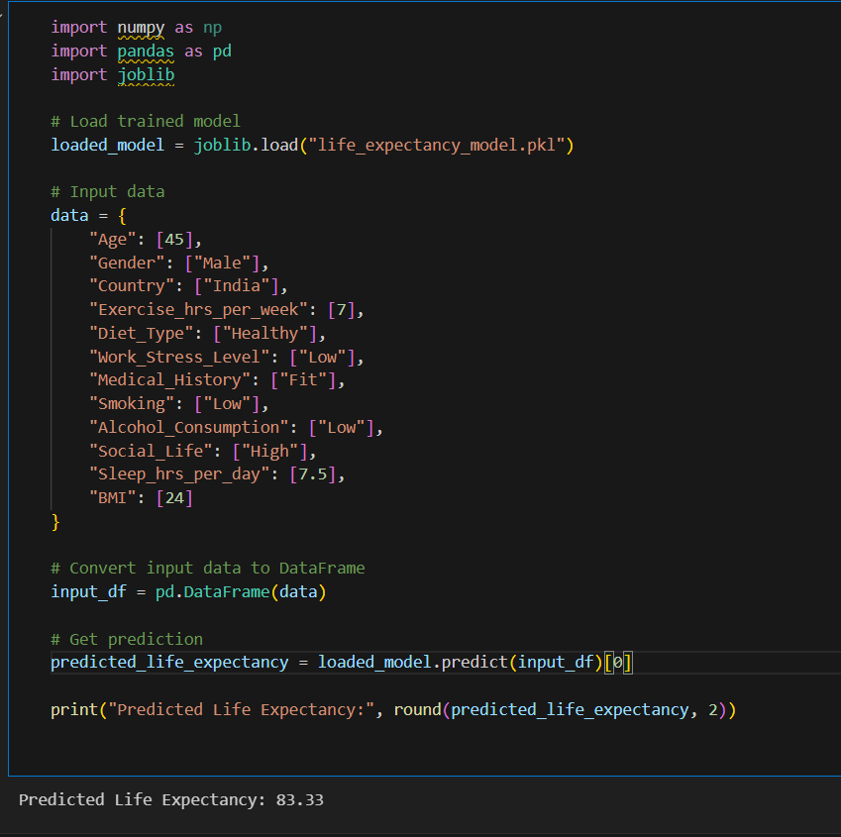

Slide 10
References
[1] World Health Organization (WHO). Life Expectancy Data. Retrieved from: https://www.who.int
[2] Eda Kavlakoglu and Erika Russi. "What is XGBoost?" IBM Think, IBM, https://www.ibm.com/think/topics/xgboost.
Chen, T., & Guestrin, C. (2016). XGBoost: A Scalable Tree Boosting System. Proceedings of the 22nd ACM SIGKDD International Conference on Knowledge [3] Discovery and Data Mining.
Friedman, J. H. (2001). Greedy Function Approximation: A Gradient Boosting Machine. The Annals of Statistics.
[3] Pedregosa, F., Varoquaux, G., Gramfort, A., et al. (2011). Scikit-learn: Machine Learning in Python. Journal of Machine Learning Research.

Slide 11
Next Presentation Overview
Knowledge Base Creation: How I structured and built the dataset for generative AI.
Embedding Techniques: Methods used to convert text data into numerical representations.
Vector Database Implementation: Storing and retrieving relevant information efficiently.
LLM Model Selection: Choosing the best generative model for personalized recommendations.

Slide 12
Thank You

